Slide 1

SIM Leadership Meeting
n
June 28, 2013

Slide 2
SIM Leadership Team Agenda
Agenda Topic | Lead | Time Allocated
Welcome and Opening Comments from Commissioner | Commissioner Mayhew | 10
Introduction of Chair of Leadership Team, Group Introductions | Holly Lusk | 15
SIM Overview | Dr. Flanigan | 10
The Importance of Collaboration/Consensus | Dr. Flanigan | 5
SIM Framework Overview | Randy Chenard | 10
SIM Governance Model Review | Dr. Flanigan | 20
Governance by Consensus | Dr. Flanigan | 10
Operational Plan Report | Randy Chenard | 20

Slide 3
SIM Overview
n
“…to test whether new payment and service delivery models will produce superior results when implemented in the context of a state-sponsored State Health Care Innovation Plan. These plans must improve health, improve health care, and lower costs for a state’s citizens through a sustainable model of multi-payer payment and delivery reform, and must be dedicated to delivering the right care at the right time in the right setting.”

Slide 4
Overarching High-Level View of Maine’s SIM Grant
n
This grant will position Maine to assess the full impact associated with existing healthcare test reform models by moving them to the next level through:
  Enhanced care delivery capabilities
  Greater access to high-value care information and data
  Enhanced care delivery “actor” (provider and patient) training / support
  Introduction of targeted incentives

Slide 5
SIM will not be successful without collaboration among all stakeholder
n
“If you bring the appropriate people together in constructive ways with good information, they will create authentic visions and sustainable responses to issues and opportunities within their communities and organizations.”
- David Chrislip, Collaborative Leadership Strategist

Slide 6
Transparency
Chair: HealthInfoNet
Admissions, Discharges, Trans
ED Notifications
PH Record
Statewide HIE
State: Lead Convener
- Public Reporting
--Share best practices
--What’s working, what’s not?
SIM Triple AIM GOAL Examples:
Int. BH/PH
PCP Utilization
Surgery Infection
ED Costs
Costs per Life
PAYMENT REFORM
Chair: MHMC
Data Analytics
VBP Development & Learning
Health Care Cost Workgroup
Development of Behavioral HCC Workgroup
SERVICE DELIVERY REFORM
Chair: Quality Counts
PCMH & HH Learning Collaborative
ACO Learning Collaborative Support
Leadership Development (RFP)
Behavioral Health Collaborative (RFP)
Public Reporting
Payer Populations
MaineCare
Medicare
Commercial
Self-Insured Employers
MAINE CDC
Patient Engagement
Diabetes Prevention
5 Sites Pilot w/ Community Health Workers

Slide 7
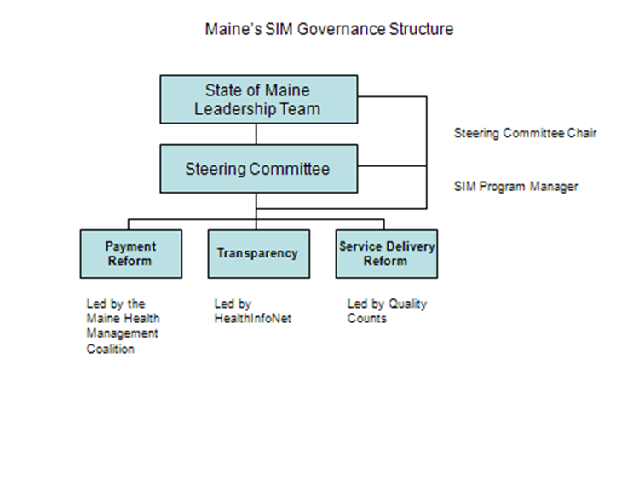
SIM Leadership Team Accountabilities
n

Slide 8
SIM Maine Leadership Team
n

Slide 9

Operational Plan Development and Review:
Timeline and Process
n
June 10 – 28 Operational Plan Development
June 28: Deadline for Content Submission
July 10: Steering Committee Begins Review and submits requests for more information
July 27:
Steering Committee Approval for Submission
Aug 1: Submission of SIM Operational Plan to CMMI
Oct 1: Deadline for CMMI approval to move into implementation phase

Slide 10
Next Steps
Future Meeting Schedule
By-Laws – Distribute today and plan to adopt at next meeting
Public Comment

Slide 11
The ‘Maine’ SIM Theme: Collaboration
n
“If you bring the appropriate people together in constructive ways with good information, they will create authentic visions and sustainable responses to issues and opportunities within their communities and organizations.”
- David Chrislip, Collaborative Leadership Strategist

